Slide 1



Hello and Welcome to
AI Camp

Slide 2
Logistic Regression
Imed Eddine Mokrane

Slide 3

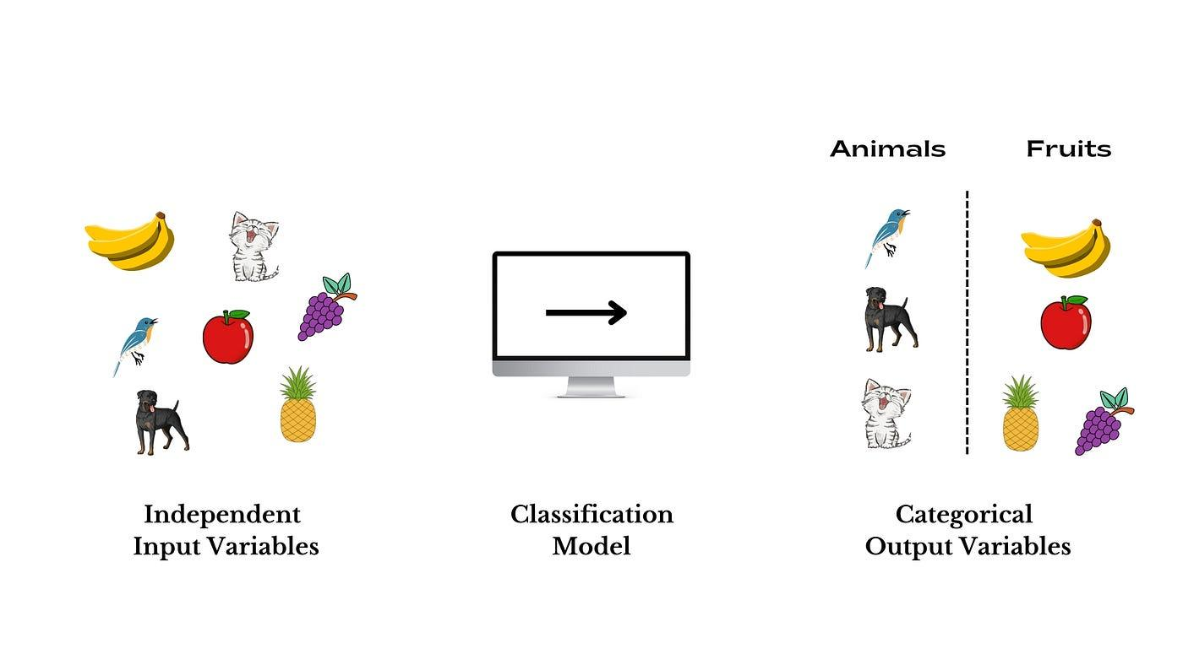
Classification Problem

Slide 4

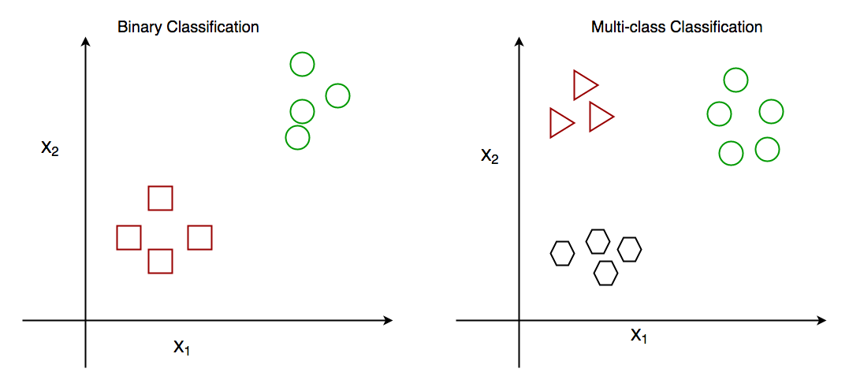
Binary VS Categorical

Slide 5


Logistic Regression
Logistic regression is a supervised machine learning algorithm that accomplishes classification tasks by predicting the probability of an outcome or event (or relex xD)

Slide 6

Logistic Regression
Linear Regression

Slide 7
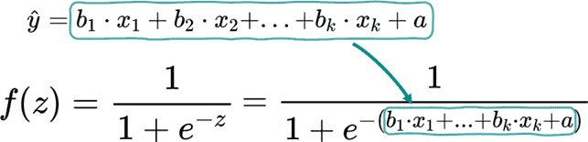


Slide 8
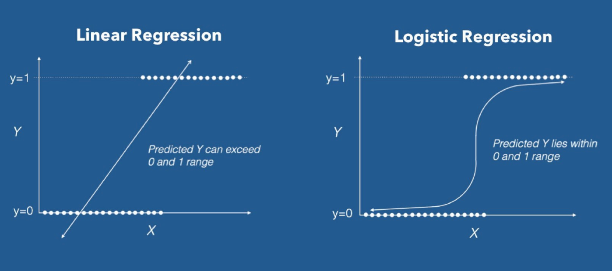

Slide 9
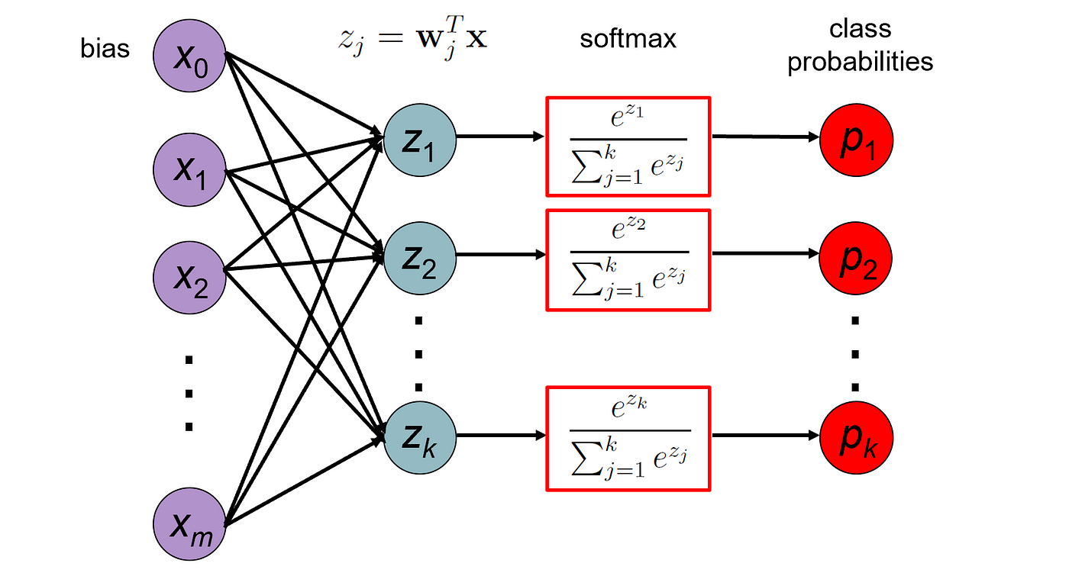
Softmax Regression

Slide 10
Loss function ?
MSE ??

Slide 11
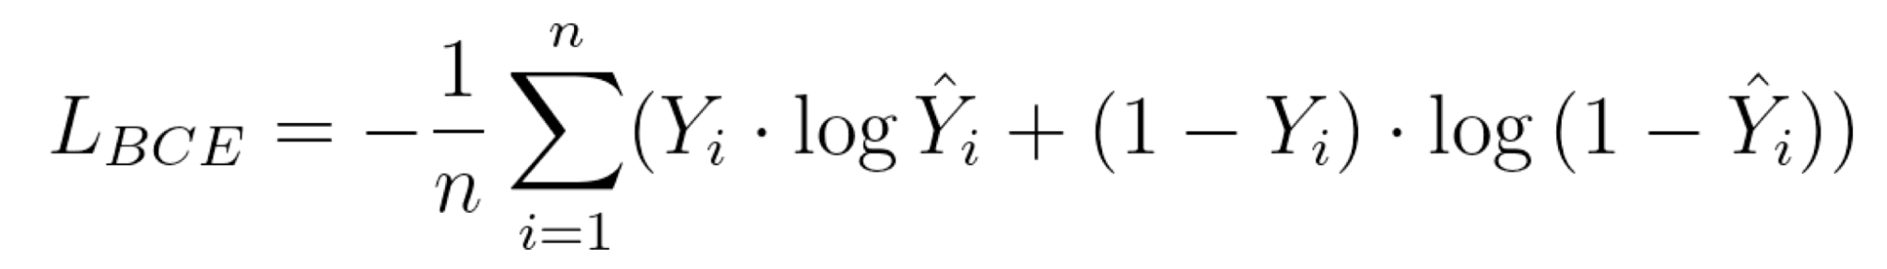
Binary Cross Entropy (BCE)
n : number of samples
Yi : actual value of sample i
Y^i : predicted value of sample i
(ma3rftch ndir chapeau)

Slide 12
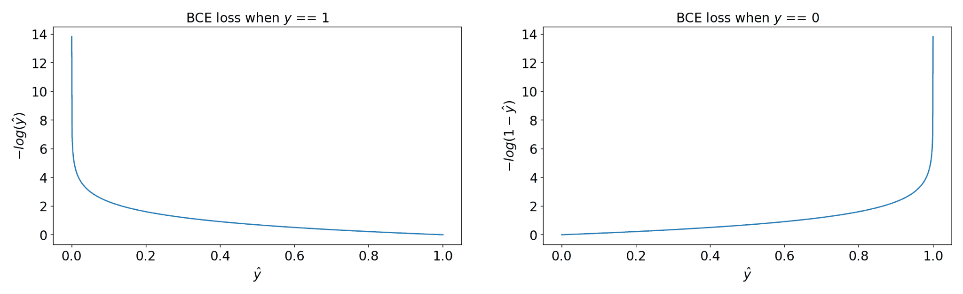

Slide 13
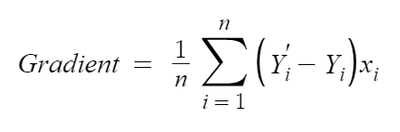
Gradient
n : number of samples
Y’ : predicted value
Y : actual value
xi : input i

Slide 14
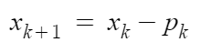
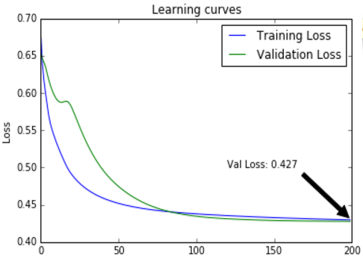
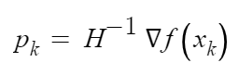
L-BFGS optimiser
The objective is to nullify the gradient
x : weights vector
p : gradient
f : cost function
H : Hessian matrix

Slide 15
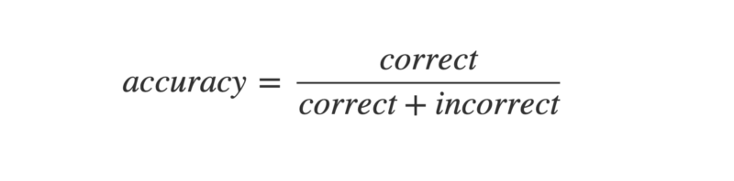
Evaluation metrics
High accuracy ⇔ Good model

Slide 16
We will predict whether a student will succeed or not
We have a group of 20 students
We made 18 correct predictions
Accuray = 18/20 = 90%

Slide 17
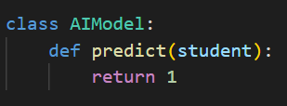
There were 18 students who succeeded !
Accuracy is not the sole indicator to determine the efficiency of our model

Slide 18
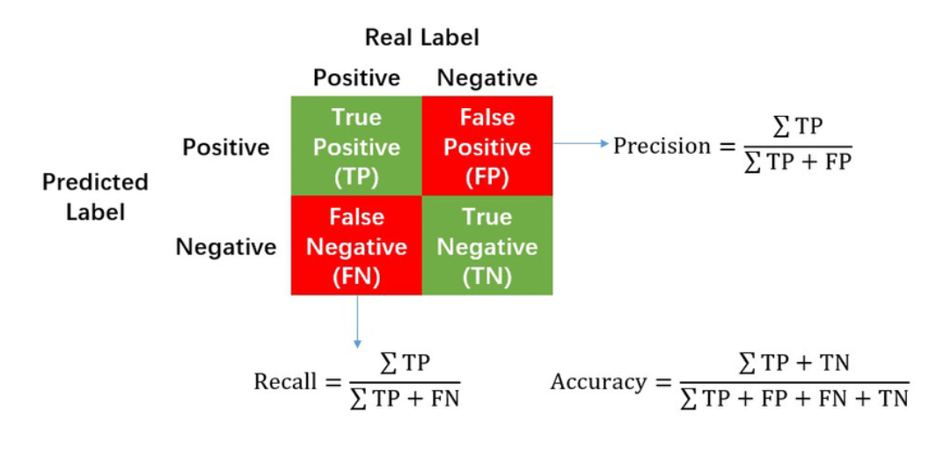
Confusion Matrix

Slide 19
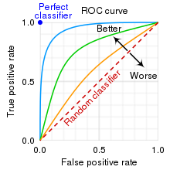
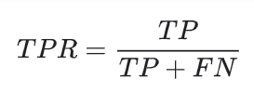
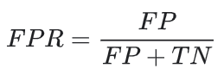
ROC - AUC

Slide 20
Let’s see some code !

Slide 21
Thank you for attending
any questions ?

